Slide 1
Cloud Native AI Introduction, Challenges and Path Forward

Slide 2
Introduction
Cloud Native Artificial Intelligence allows the construction of practical systems to deploy, run, and scale
CNAI solutions address challenges AI application scientists, developers, and deployers face in developing, deploying, running, scaling, and monitoring AI workloads on cloud infrastructure.

Slide 3
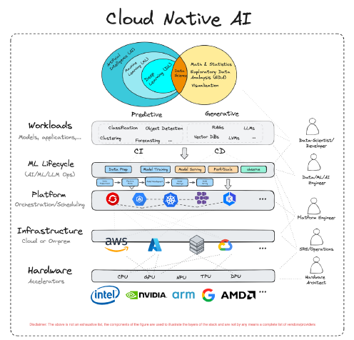
Why Cloud Native Artificial Intelligence?
With its elastic, always-on infrastructure, the cloud has allowed enterprises, startups, and developers to prototype quickly, offer new services, scale solutions, and much more.
The average user no longer has to worry about ordering hardware or dealing with logistics like space, power, network connectivity, cooling, software licensing, and installation.
AI has similar concerns – rapid prototyping, accessing storage, networking, and computing resources to tackle small and large-scale training and inference tasks.

Slide 4
CHALLENGES FOR CLOUD NATIVE ARTIFICIAL INTELLIGENCE
Data Preparation
Data preparation for cloud native artificial intelligence poses unique challenges due to the distributed nature of data sources and the dynamic infrastructure of cloud environments
Ensuring data consistency, quality, and accessibility across disparate systems and platforms requires robust orchestration and integration capabilities
Efficient data governance frameworks and scalable data pipelines are essential to overcome these challenges and enable seamless integration of AI capabilities in cloud native environments.

Slide 5
CHALLENGES FOR CLOUD NATIVE ARTIFICIAL INTELLIGENCE
Model Training
Model training in cloud native artificial intelligence presents several unique challenges:
Resource Scalability: Ensuring sufficient compute resources to scale training processes dynamically based on workload demands.
Data Management: Efficiently handling large volumes of training data distributed across cloud environments while ensuring data integrity and accessibility.
Container Orchestration: Managing and orchestrating training jobs using containerized environments (e.g., Kubernetes) to optimize resource utilization and scalability.
Monitoring and Debugging: Implementing robust monitoring and logging mechanisms to track model performance, diagnose issues, and optimize training workflows in a distributed cloud-native setting.

Slide 6
CHALLENGES FOR CLOUD NATIVE ARTIFICIAL INTELLIGENCE
Model Serving
Model serving for cloud native artificial intelligence presents several challenges that need to be addressed for efficient and scalable deployment:
Scalability and Resource Management: Ensuring that model inference can scale dynamically based on workload demands while efficiently managing computational resources like CPU, memory, and GPU resources.
Versioning and Deployment: Managing multiple versions of AI models and deploying them seamlessly across distributed environments, ensuring backward compatibility and smooth transitions.
Real-time Inference and Latency: Meeting stringent latency requirements for real-time inference, especially in applications like streaming analytics or online recommendations, requires optimizing model serving pipelines and leveraging edge computing.
Monitoring and Observability: Implementing robust monitoring and observability tools to track model performance, detect anomalies, and ensure reliability, especially in complex distributed environments involving microservices and container orchestration platforms like Kubernetes.

Slide 7
CHALLENGES FOR CLOUD NATIVE ARTIFICIAL INTELLIGENCE
User Experience
Adoption of cloud native technologies (e.g., containers, Kubernetes) enables portability and scalability but presents a steep learning curve for users transitioning from traditional systems.
Seamless AI Pipeline Development: Providing a streamlined user experience for AI practitioners involves offering user-friendly Python SDKs that abstract away Kubernetes complexities.
Bridge Between Big Data and ML Ecosystems: It requires enhancements in data loading tools and integration of large-scale data preparation solutions to optimize IO overhead in training workloads.
Simplifying Deployment and Maintenance: Simplifying the deployment and upgrade paths for ML workloads on Kubernetes, including managing GPU drivers and ensuring resilience to Kubernetes upgrades, is essential for user adoption and ease of maintenance.
User Experience and Observability: Improving multi-tenancy management with clear resource allocation tools and enhancing observability and debugging capabilities are critical for non-admin users to navigate complex distributed environments effectively.

Slide 8
PATH FORWARD WITH CLOUD NATIVE ARTIFICIAL INTELLIGENCE
Recommendations for Implementing CNAI:
Embrace flexibility by leveraging popular tools and techniques that interface with cloud resources effectively, ensuring adaptability to evolving AI offerings.
Enhance sustainability by improving accountability for AI workload environmental impact, integrating cloud native technologies for workload optimization, and advocating standardized methodologies for environmental impact assessments.
Address custom platform dependencies by ensuring cloud native environments support necessary GPU drivers and configurations critical for AI applications.

Slide 9
PATH FORWARD WITH CLOUD NATIVE ARTIFICIAL INTELLIGENCE
Evolving Solutions for AI/ML:
Orchestration with Kubeflow: Utilize Kubeflow as a Cloud Native AI tool supporting ML Operations (MLOps) by leveraging Kubernetes for scalable and efficient AI/ML workflows.
Context with Vector Databases: Implement vector databases to enrich AI model prompts, enabling diverse input handling and context enrichment for Generative AI systems.
Observability via OpenLLMetry: Leverage OpenLLMetry for comprehensive Observability of Generative AI, aiding in improving model performance and fine-tuning workflows.

Slide 10
PATH FORWARD WITH CLOUD NATIVE ARTIFICIAL INTELLIGENCE
Opportunities for Further Development:
CNCF Project Landscape: Explore Linux Foundation groups like CNCF for AI projects and tools, providing educational and collaborative opportunities for AI and cloud engineers.
CNAI for Kids and Students: Introduce educational programs focusing on AI technologies early to foster inclusivity and diversity in AI development and adoption.
Trust and Safety / Safety By Design: Prioritize responsible AI and Cloud Native technology development by embedding safety and ethical considerations into design and development processes.

Slide 11
FUTURE OF CNAI
The future of CNAI will witness the convergence of hybrid cloud architectures, integrating public cloud, private cloud, and edge computing for optimized AI workloads.
Advancements in Kubernetes-based AI orchestration will continue, enabling end-to-end lifecycle management of AI applications with efficient resource utilization and scalability.
Expect deeper integration of AI/ML capabilities into cloud native infrastructure, fostering the development of specialized platforms that simplify AI deployment and management while prioritizing responsible AI practices and ethical considerations.

Slide 12
THANK YOU

